Slide 1
Robot, Pass Me the Tool: Handle Visibility Facilitates Task-oriented Handovers
Valerio Ortenzi, Maija Filipovica, Diar Abdlkarim, Tommaso Pardi, Chie Takahashi, Alan M. Wing, Massimiliano Di Luca, Katherine J. Kuchenbecker

Slide 2
Why did we choose this paper?
Understading the evolution of robotic when needing to collaborate with human workers on physical tasks
Understanding how humans perceive a tool depending on the visbility level

Slide 3
Hypothesis
How visual occlusion of the object being passed by a robot influences the quantitative grasp planning and reaching performance and the subjective evaluation by the human receiver

Slide 4
Materials and Methods
A VR experimente using Unity (Unity Technologies) was developed
Oculus Quest VR headset (Facebook Technologies)
The experimental scene consisted of a fixed-base KUKA LBR iiwa robot arm located on a table in the center of a room and equipped with a three-fingered gripper (BarrettHand BH8-262)

Slide 5
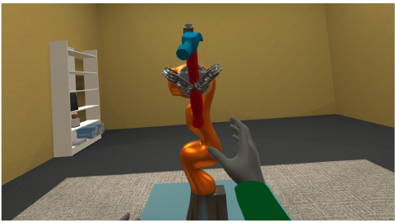
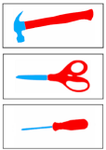
Materials and Methods
3 objects were used: scissors, hammer and screwdriver
Unity based grasp simulator called PrendoSim was used to generate over 1000 grasps
These grasps were separated based on the visibility level : 0-40%, 40-60%, 60–80% and 80-100%

Slide 6
Materials and Methods

